Slide 1
AzureFoundation
Microsoft
Cloud Solution Architects

Slide 2
Agenda

Slide 3

What’s in the AzureFoundation for Nonprofits?
Azure Value Proposition Checklist/Prerequisites Architecture Overview Modules
Management and Monitoring
Security and Identity Network Pattern Security Pattern Configuration Details

Slide 4
Value Proposition

Slide 5
Application innovation
Accelerate innovation with the cloud
Data and intelligence
Power decisions & apps with insights
Microsoft Azure
Openness and flexibility
Build freely, deploy anywhere
Trust
Protect your business
Notes:
Microsoft Azure is our cloud platform for digital transformation across your business. Our strategy to this end is to provide a platform of technologies that:
1. Accelerates app innovation through rapid app development and agility in the cloud.
2. Delivers integrated data and intelligence—data for rich insights to intelligence embedded within apps.
3. Is open and flexible, where you can use the tools and technologies you already have and want to use.
4. Is trusted to protect your business assets. As more customers expect digital experiences, they expect the data they share with an organization to be protected. We help you do that.
Let’s discuss these areas in more detail.

Slide 6

AzureFoundation for Nonprofits Problem Statement
New cloud enrollments often don’t get utilized because the technical and business stakeholders are not aware of the cloud adoption strategy
Financial and technical stakeholders often change, causing long delays if Azure enterprise roles are assigned to individuals.
Single Sign-on is a value customers would like, yet is often perceived as being too difficult to implement.
Role based access control, data classification and network security is perceived as difficult to implemet.
Staff isn’t enabled to deploy workloads securely with a culture of continuous learning.
Hybrid integration of cloud resources, identity, operations, network and security with on premise systems is a great differentiator of Azure to other clouds
Partner assistance is not easy to communicate .

Slide 7

Cloud Value Proposition
Eliminate capital expenses
Infrastructure resource management in a matter of minutes
Elasticity to scale up and down to meet business requirements
Decrease time to market
Application development and modernization platform
Spend more time on productivity tasks
Better performance with enterprise class computing resources
Resiliency to ensure maximum business continuity

Slide 8

AzureFoundation Value Proposition
AzureFoundation patterns:
Hybrid identity
Partner community
Financial accounting structure
Segregation of environments (Hub Services, Pre-Prod, Prod, High Business Impact, storage)
Hybrid networking and identity for the enterprise
Baseline security of Azure with default network security groups, role based access control.
Establish naming conventions with metadata for a best of breed greenfield geo-redundant datacenter
Production ready: Disaster Recovery, Data Center migration, HA SharePoint and HA SQL Server Farm
Templated pattern deployment for CI/CD
Serverless patterns for common cognitive service pipeline (coming soon)

Slide 9
Prerequisites and Checklist

Slide 10
AzureFoundation Checklist
Prerequisites:
An Azure Enrollment with Enterprise Administrator access
Two Account Administrator service account assigned to each Department.
A Class B (/16) IP space per Department.
A supported VPN device.
A business and technical stakeholder to review configuration settings.
Managing and Monitoring Standards
Identity Standards
Policy Standards
ExpressRoute Peering
Goals and Desires for the Cloud
Sandbox Environment (A, B)
Hybrid Networking/Identity (A, B, C, D, E, F, G, H)
Modern Applications or PaaS (A, B, E, F, G, H)
Production Workloads (A, B, E, F, G, H)
Microsoft SaaS Application (A, B, G, H)

Slide 11
The AzureFoundation Modules

Slide 12

Technology Used in AzureFoundation
Excel managed Metadata
Azure Enrollment
Azure Departments, Accounts, Subscriptions
Azure Resource Model (ARM)
Resource Groups
Template Deployments
Role Based Access Control
Azure Compute/Networking
Virtual Machines (VMs)
Virtual Networks (VNETs)
Network Security Groups (NSG)
(Optional) User Defined Routing (USR)
Visual Studio Team Services
Visual Studio

Slide 13

Modules
Compute: (Resilient Identity, Service Fabric, HA SharePoint Farm, HA SQL Cluster)
Networking: (VNET, Network Virtual Appliances)
Web & Mobile
Databases & Storage (Coming Soon)
Intelligence & Analytics (Coming Soon)
Internet of Things & Enterprise Integration (Coming Soon)
Security + Identity (Multi-region hybrid identity, Security Center)
Developer Tools (coming soon)
Monitoring and Management (Monitoring, LogAnalytics, Security Center and Departments, Accounts and Subscriptions)

Slide 14
Security and Identity

Slide 15


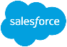



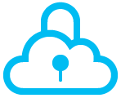
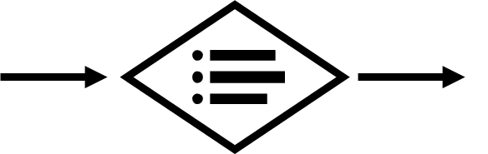


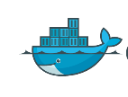



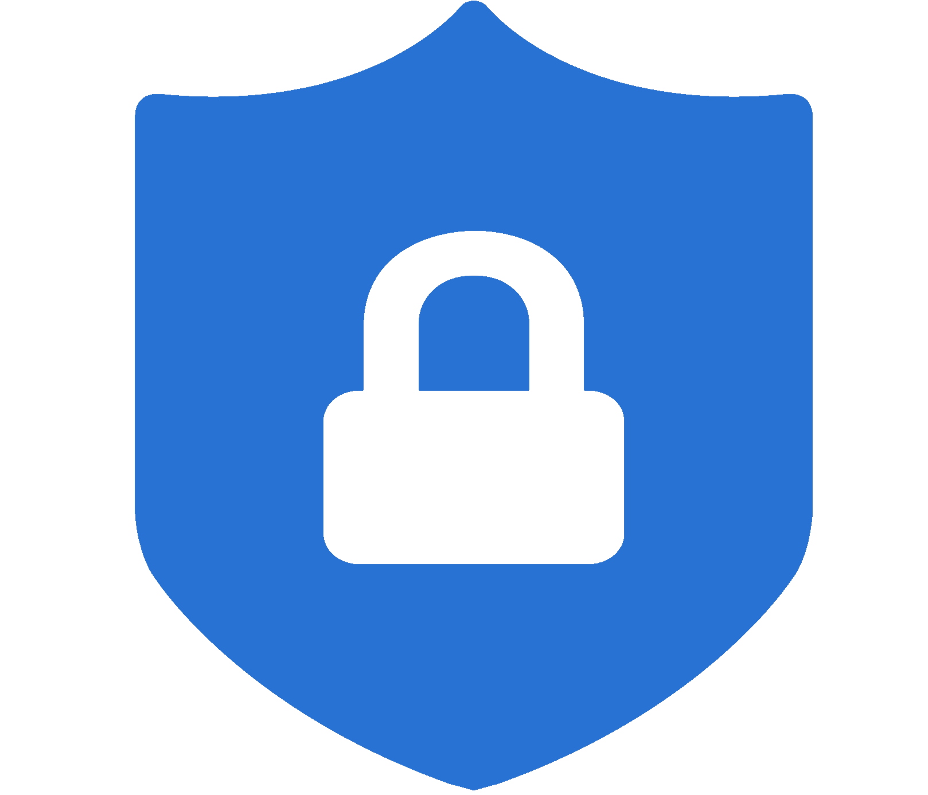
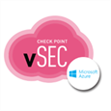

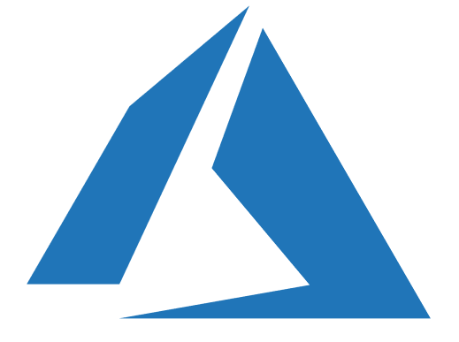
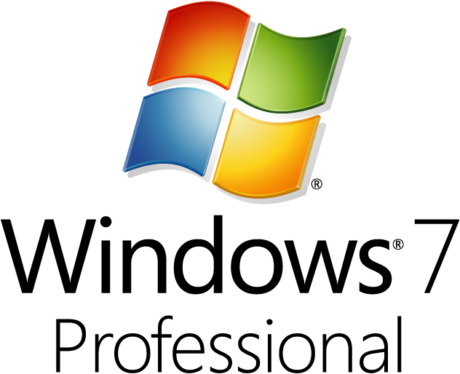




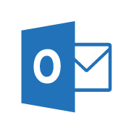
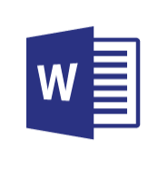
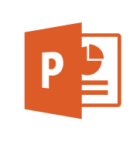
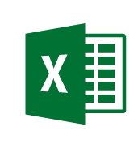
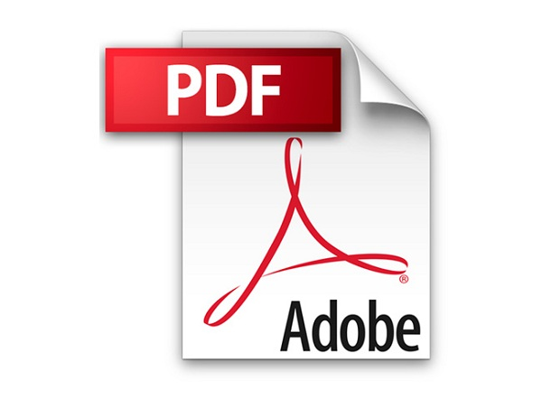







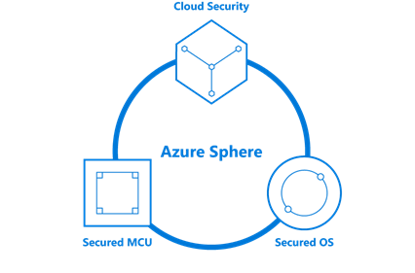


Security Operations Center (SOC)
Cybersecurity Reference Architecture
May 2018 – https://aka.ms/MCRA | Video Recording | Strategies
Software as a Service
Vulnerability Management
Cybersecurity Operations Service (COS)
Office 365
Incident Response and Recovery Services
Secure Score
MSSP
Azure
Security Center
Windows Defender
Office 365
Security & Compliance
Azure
Customer Lockbox
SIEM + Analytics
This is interactive!
Present Slide
Hover for Description
Click for more information
Roadmaps and Guidance
Securing Privileged Access
Office 365 Security
Rapid Cyberattacks (Wannacrypt/Petya)
Cloud App
Security
Advanced Threat Protection (ATP)
Dynamics 365
Identity & Access
Graph Security API (Public Preview)
Information Protection
Azure Active Directory
Alert & Log Integration
Conditional Access – Identity Perimeter Management
Clients
Hybrid Cloud Infrastructure
Cloud App Security
Azure AD Identity Protection
Leaked cred protection
Behavioral Analytics
Unmanaged &
Mobile Devices
On Premises Datacenter(s)
3rd party IaaS
Microsoft Azure
Azure Information Protection (AIP)
Discover
Classify
Protect
Monitor
Azure Security Center – Cross Platform Visibility, Protection, and Threat Detection
Configuration Hygiene
Just in Time VM Access
Azure AD PIM
NGFW
Security Appliances
Adaptive App Control
Multi-Factor Authentication
Intune MDM/MAM
Classification Labels
Managed Clients
Extranet
Edge DLP
Azure Policy
Hold Your Own Key (HYOK)
Azure AD B2B
SSL Proxy
Azure Key Vault
AIP Scanner
Azure AD B2C
IPS
Hello for Business
Express Route
Azure WAF
System Center Configuration Manager
Windows Server 2016 Security
Window 10 + Just Enough Admin, Hyper-V Containers, Nano server, and more…
Azure Antimalware
Office 365
Data Loss Protection
Data Governance
eDiscovery
MIM PAM
Windows Defender ATP
Network Security Groups
Azure ATP
Shielded VMs
VMs
Intranet Servers
Backup & Site Recovery
Azure Stack
Azure SQL
Threat Detection
Active Directory
Secure Score
Threat Analytics
Privileged Access Workstations (PAWs)
Disk & Storage Encryption
SQL Encryption & Data Masking
ESAE Admin Forest
Windows 10 Enterprise Security
IoT and Operational Technology
Included with Azure (VMs/etc.)
Premium Security Feature
Confidential Computing
Azure SQL Info Protection (Preview)
Network protection
Credential protection
Exploit protection
Reputation analysis
Full Disk Encryption
Attack surface reduction
App control
Isolation
Antivirus
Behavior monitoring
DDoS attack Mitigation+Monitor
Windows 10 IoT
Azure Sphere
IoT Security Maturity Model
Endpoint DLP
Azure IoT Security
IoT Security Architecture
Compliance Manager
S Mode
Security Development Lifecycle (SDL)
Trust Center
Intelligent Security Graph
Notes:
https://gallery.technet.microsoft.com/Cybersecurity-Reference-883fb54c
BUILD SLIDE VERSION (Animated Build sequence that takes ~25 clicks)
Key Takeaway: This is the Microsoft Cybersecurity Reference Architecture (https://aka.ms/MCRA) which describes Microsoft’s cybersecurity capabilities and how they integrate with existing security architectures and capabilities.
The latest version of this diagram, associated presentation video (on v1 version currently), and the complementary cybersecurity reference strategies can be found at the links at the top. Links to key guidance are also included for important and complex initiatives like securing privileged access, Office 365, and protecting against attack like Petya/Wannacrypt.
This diagram is interactive, you can hover over any of the capabilities for a quick description and then click on it for more documentation on the capability.
CLICK 1
We have found that most enterprise organizations have Windows and Linux servers (and often applications containers) to protect. Most have also established a basic core set of security capabilities at the network edge / egress points to protect extranet and intranet resources.
CLICK 2
We also commonly find that enterprises also have a range of client devices to support and protect ranging from corporate issued PCs to Bring Your Own Device (BYOD) personally owned mobile devices.
CLICK 3
Many enterprise organizations have established a operational security capability that includes vulnerability management and incident management, which is typically provided by an on-premises Security Information Event Management (SIEM) capability or a Managed Security Services Provider (MSSP).
CLICK 4
Many have also deployed endpoint Data Loss Prevention (DLP) capability to help with information protection needs.
CLICK 5
Most larger organizations have Active Directory as a primary enterprise directory (frequently as part of an identity system that includes other capabilities for identity lifecycle management, credential vaulting, and other needs)
CLICK 6
Most enterprises estates include Software as a Service (SaaS) like Office 365 and other popular services. Some of these are sanctioned and configured by corporate IT, but others are “Shadow IT” adopted by business units and individual user without the knowledge or endorsement of corporate IT.
CLICK 7
Many organizations also operate traditional Industrial Control Systems (ICS) including Supervisory Control and Data Acquisition (SCADA) technology. Many are also operating or planning to adopt Internet of Things (IoT) technology for both internal systems and customer product offerings.
CLICK 8
Additionally, the scope of enterprise infrastructure has grown into a hybrid state that incorporates Infrastructure as a Service (IaaS) and Platform as a Service (PaaS) from Microsoft Azure as well as other IaaS providers.
Pausing for a moment, this leaves most enterprises with a “hybrid of everything” estate to manage and secure, which is quite challenging given the steadily increasing volume and sophistication of cybersecurity threat actors.
CLICK 9
The foundation of Microsoft’s cloud services and products starts with trust and high security standards.
Trust Center – Microsoft offers the most comprehensive set of compliance offerings of any cloud service provider. We transparently provide information on how we meet or exceed those standards in our trust center.
Compliance Manager - We built a capability to help you manage your compliance requirements (based heavily on what we learned while managing compliance of our cloud services such as extensive mapping of controls across multiple standards)
Security Development Lifecycle - We have also published documentation from our industry leading security development lifecycle openly to help you with securing your applications.
Intelligence Security Graph – Through the course of supporting, operating, and securing our cloud services and Windows PCs, Microsoft has accumulated a massive set of first party threat intelligence (measured in the trillions of signals) that we use to protect our cloud services, IT environment, and customers. Many of the products in this architecture have integrated intelligence and analytics from the security graph directly into threat detections and security guidance.
CLICK 10
Familiar network edge capabilities from popular vendors are available in the Azure Marketplace to enable customers to extend on premises controls to the cloud.
CLICK 11
While Microsoft invests deeply into Azure platform security, we see common security risks as customers first move to the cloud. The hybrid infrastructure model and the cloud security/networking controls are new to many professionals so we frequently see some inadvertent configuration errors lead to security risk.
Microsoft has invested into Azure Security Center (ASC) to enable you to
Protect servers and workloads across any cloud and on-premises datacenters
Detect and correct common misconfiguration issues such as
VMs exposed directly to the internet
Missing Web Application Firewalls (WAFs) for web applications
Out of date patches and antimalware signatures
…and many others
Leverage cutting edge capabilities in Azure like machine learning to suggest firewall rules and application whitelists (to allow/block which files can run on servers)
CLICK 12
Microsoft has also invested heavily in other Azure security capabilities such as Distributed Denial of Service (DDoS) mitigations, key management, ransomware-resistant backup archives, confidential computing capabilities to protect data while its being processed, and many more.
CLICK 13
Microsoft has also continued to invest into on-premises security capabilities for Windows Server (including Shielded VMs) and Azure Stack (which provides the ability to run Azure services in your on-premises datacenter)
CLICK 14
Microsoft has also focused heavily on device security with
System Center Configuration Manager and Intune MDM/MAM for cross platform security and management across Windows, Linux, Mac, iOS, and Android
Windows 10 Enterprise Security - An extensive set of platform capabilities to protect against ever-evolving attacks
Windows Defender ATP – Advanced endpoint detection and response (EDR) capabilities to rapidly detect and recover from attacks as well as management, monitoring, and security planning capabilities to keep devices healthy and secure.
CLICK 15
Based on lessons learned from credential theft and similar attacks, Microsoft has invested in securing privilege access including privileged access management, advanced credential/identity attack detection and privileged access workstation (PAW) architectures. Our PAW investments includes
Publishing Guidance – We have published detailed installation instructions for customers to build their own PAWs
Platform Security – We protect our IT Environment and cloud services with a full admin workstation program (internally called Secure Access Workstations or SAWs)
CLICK 16
Because of how critical identity is to security, Microsoft has invested heavily in security capabilities to protect and manage cloud and on-premises identities spanning multi-factor authentication, biometrics, hardware protection of credentials (via TPM and virtualization based security), applying threat intelligence + machine learning to authentication attempts, and more.
CLICK 17
Identity is also critical for protecting data and operational availability as it’s frequently the only control type available across modern IoT/mobile/etc. devices and cloud services. Organizations should focus on build an identity security perimeter to consolidate management of authentication and access controls and enforce consistency. Microsoft has invested into Conditional Access to enable simple (and powerful) visibility and policy control of this new perimeter.
CLICK 18
Microsoft has invested across our tools to enable integration with your existing Security Information and Event Management (SIEM) solution.
CLICK 19
Microsoft has built a complete set of Advanced Threat Protection (ATP) technology to enable SOCs to monitor all the assets in the modern estate (SaaS/PaaS/IaaS, Identity, Data, Devices, etc.) and rapidly respond and remediate threats across them. This will enable you to transform your SOC using the massive set of Microsoft threat intelligence in the intelligent security graph (bottom right of slide) and integrate these with your existing capabilities using the Graph Security API (currently in public preview).
CLICK 20
Microsoft also offers professional services to help you investigate incidents in your environment as well as to hunt for potential existing threats.
CLICK 21
Microsoft has built several Office 365 security capabilities to enhance your security planning (Secure Score), add additional explicit approval steps before Microsoft support can access your data for support issues (Customer Lockbox), and data protection technologies built into the platform.
CLICK 22
Cloud App Security is a Microsoft Cloud Application Security Broker (CASB) offering that provides a wide array of security capabilities for SaaS including Shadow IT Risk management, Policy Monitoring and Enforcement, Information Protection, and incident detection/response/recovery.
CLICK 23
Azure Information Protection – Protects information at the file itself so the encryption and policy control can follow files wherever they go (Cloud, Devices, USB drives, etc.).
CLICK 24
Additionally, Microsoft has invested in advanced security capabilities for data in SQL to protect against common threats and simplify information protection management and policy.
CLICK 25
Microsoft is also investing heavily into OT and IoT security to help manage and secure existing (brownfield) platforms, provide secure (greenfield) platforms, and help manufacturers quickly determine what level of security they need and enable them to rapidly and easily achieve that.
CLICK 26
We understand this is a lot of capabilities to plan for, so we have built several prescriptive roadmaps to help organizations quickly mitigate risk from critical and complex cybersecurity challenges.
Feedback
We are always trying to improve everything we do at Microsoft and we need your feedback to do it! You can contact the primary author (Mark Simos) directly on LinkedIn (https://aka.ms/markslist) with any feedback on how to improve it or how you use it, how it helps you, or any other thoughts you have.

Slide 16
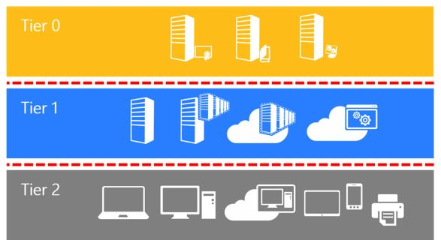
Securing Privileged Access
The AzureFoundation is designed to have Network Security Groups that will allow for privileged users to have access to workstations.
Tier 0 - Direct Control of enterprise identities in the environment. The security sensitivity of all Tier 0 assets is equivalent as they are all effectively in control of each other.
Tier 1 - Control of enterprise servers and applications. A common example role is server administrators who maintain these operating systems with the ability to impact all enterprise services.
Tier 2 - Control of user workstations and devices. Tier 2 administrator accounts have administrative control of a significant amount of business value that is hosted on user workstations and devices. Examples include Help Desk and computer support administrators because they can impact the integrity of almost any user data.
Notes:
https://docs.microsoft.com/en-us/windows-server/identity/securing-privileged-access/securing-privileged-access-reference-material

Slide 17


Domain Integration
DNS Request for domain validation. Azure DNS to host Zone. (contoso.org)
3 Virtual Machine to synchronize Azure Active Directory (AAD) with Active Directory Domain Controllers (ADDC)
Create Global Administrator account with AAD Tenant that to synchronize/replicate hybrid identity.
AD Domain Administrator Configuration of AAD Connect appliance. Service account for synchronization service.

Slide 19
Azure Security Center
Notes:
https://www.cisecurity.org/benchmark/azure/

Slide 20
Monitoring and Management

Slide 21
Azure Governance References
https://docs.microsoft.com/en-us/azure/governance/

Slide 22
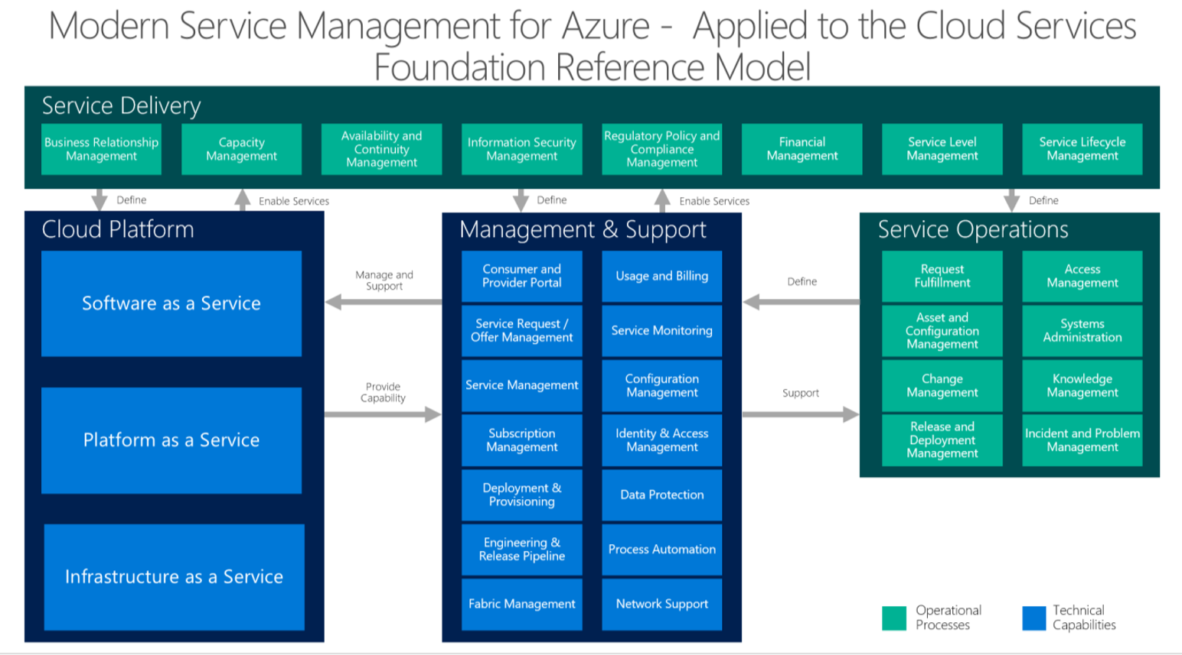

Slide 23

Common Onboarding Issues and Limitations
When Adding another Enterprise, Department or Account Administrator the portal gives an error message “Invalid Account”. This is caused because the setting on the Enrollment Tab for “Auth Level” isn’t set to “Work or School Account Cross Tenant”
When Adding an Enterprise Administrator an error that the person is already a Department Administrator. The Department Administrator needs to be different, find a backup and make the backup be the Department Administrator.
An Account owner can only own one account. If an account allows “work or School Account Cross Tenant” there is a risk if another organization’s Account Owner has subscriptions, those subscriptions will migrate to your EA.
If the first account owner in a subscription is a Microsoft Account (not a work or school account) the tenant will be named after the Microsoft Account associated with the Account.

Slide 24

Stakeholder Personas
System Owner
Agency Information Security Officer
Information System Security Manager
Agency Assessors
Operations Team
Authorizing Official
https://blogs.msdn.microsoft.com/azuregov/2016/08/11/stakeholders-in-the-authorization-to-operate-process/

Slide 25
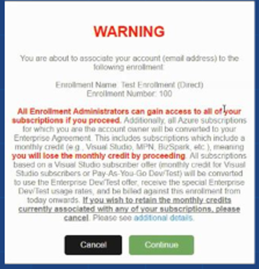
Important Information about Account Owners
The first time you login to the EA Portal as an account owner you will see this Warning Message:
It is important to read and understand because your existing subscriptions are about to be converted ad benefits can be lost.
A Visual Studio subscriber who is added as an Account Owner will lose their individual monthly Azure credit until they take further action.
If a sponsored account is associated to a Microsoft (MSA) account, that account can be added to the Enterprise Admin portal and all of the subscriptions will roll over without any change. (see picture).

Slide 26

Financial Reporting for Enterprise Enrollment
Can’t get financial reports from Azure?
There is a brief demo here.
https://channel9.msdn.com/blogs/EA.Azure.com/Using-the-EA-Azure-Power-BI-Link
To Set up a demo, use Enrollment Number “100” and the key.
Practice what your customer is seeing (see notes)
Azure Government Onboarding
Blog Post on PowerBI
Notes:
Access the Demo Environment:
· Join the WAEPField security group
· Once permissions propagate, sign in at https://waepuat.cloudapp.net/ using Microsoft Account authentication as specified below using the password Azure##1:
o Direct Agreement Demo
§ Enterprise Administrator: WAEP_EA_1@live.com
§ Account Owners: WAEP_AO_1@live.com, WAEP_AO_2@live.com
o Indirect Agreement Demo
§ Partner Administrator: WAEP_PA@live.com
§ Enterprise Administrator: WAEP_IEA@live.com
§ Account Owners: WAEP_IAO@live.com, WAEP_IAO1@live.com
· Access the 1 Direct Customer Agreement or 1 Indirect Customer Agreement based on the persona you intend to demo

Slide 27
Financial Setup Using Departments
Microsoft Azure Commercial (MAC) and Government (MAG) will each have an enrollment number
For a State or County, each agency may have their own
There will be two accounts, one for Managed and Sandbox Workloads
There are five default subscriptions that each Managed Account

Slide 28
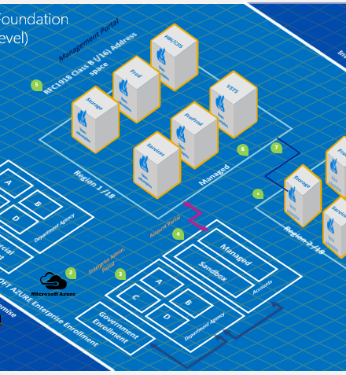
Visualization
Two Enrollments
Multiple Departments
Two Accounts per Department
Five Managed Subscriptions
Multiple Sandboxes
Two Regions
IP space carved from /16 RFC1918

Slide 29

Pattern Overview
Configuration of at least 1 Department and one Account
Assign one Department Administrator (DA) that is different than the Enterprise Administrator. Suggest using a Service Account, versus a named user, as people change.
Create subscriptions, renamed to match the type of workloads that they will hold.
Production, this is where production workloads will go, example, Sharepoint Farm
HBI/CJIS, this is where production high business impact (HBI) or Criminal Justice Information System CJIS workloads will go, example, Evidence Management System
Preproduction, this is where Application Lifecycle Management (ALM) workloads go, such as Test servers
Services, are production workloads that are required to be accessible by everyone, yet have extremely sensitive data (level 5 Password data), example Windows Active Directory Domain Controllers.
Storage, where on premise (non-Azure) storage is maintained, example StorSimple.
VSTS subscription is required if the enterprise wishes to associate a Visual Studio environment and licenses to the Enrollment, one per VSTS site.
Standbox Subscriptions in the Sandbox Account that are never connected to the enterprise.
Deploy Secure Single Sign-on for O365 Identity

Slide 30
Alternative Approaches
One (or more) Subscription(s) versus Five Subscriptions
Using one or five or more subscription can be facilitated by modifying the subscription that is associated to VNET.
Consider that one subscription will remove an important way to categorize workloads, either by environment or workload.
Network, Identity, Site Redundancy
Using a single Azure region and only one VPN will save costs.
Consider that redundancy in the single region could be obtained with two regions with small incremental costs, removing risk.
PaaS only deployments
No requirements for IPv4 or internal networking.
Consider having the templates for networking ready in the event a hybrid network is required.

Slide 31

Bill of Materials
Notes:
https://microsoft.sharepoint.com/teams/SLGCloudTeam/azure/Shared%20Documents/1.%20Onboarding%20Customers/Workload%20Architectures/Foundation/3D_Blueprint_Foundation_Working.vsdx?web=1
Or
https://microsoft.sharepoint.com/teams/SLGCloudTeam/azure/Shared%20Documents/2.%20Consumption/Architecture/Foundation/AF_Simple_Working.vsdx?web=1

Slide 32
Azure Site Recovery
The majority of these questions are answered in our public documentation for Site Recovery with all of the current features and limitations.
You can see the Azure Gov differences at: https://docs.microsoft.com/en-us/azure/azure-government/documentation-government-services-monitoringandmanagement.
The documentation does a good job of breaking down how-tos by workload like SQL Server.
I’d also check out the Learning Path on ASR: https://azure.microsoft.com/en-us/documentation/learning-paths/site-recovery/

Slide 33
Monitoring Azure
Notes:
https://docs.microsoft.com/en-us/azure/security-center/security-center-export-data-to-siem

Slide 34
Compute

Slide 35
List of Patterns:
Resilient Identity
High Availability SharePoint farm
Remote Desktop Services or Citrix

Slide 36
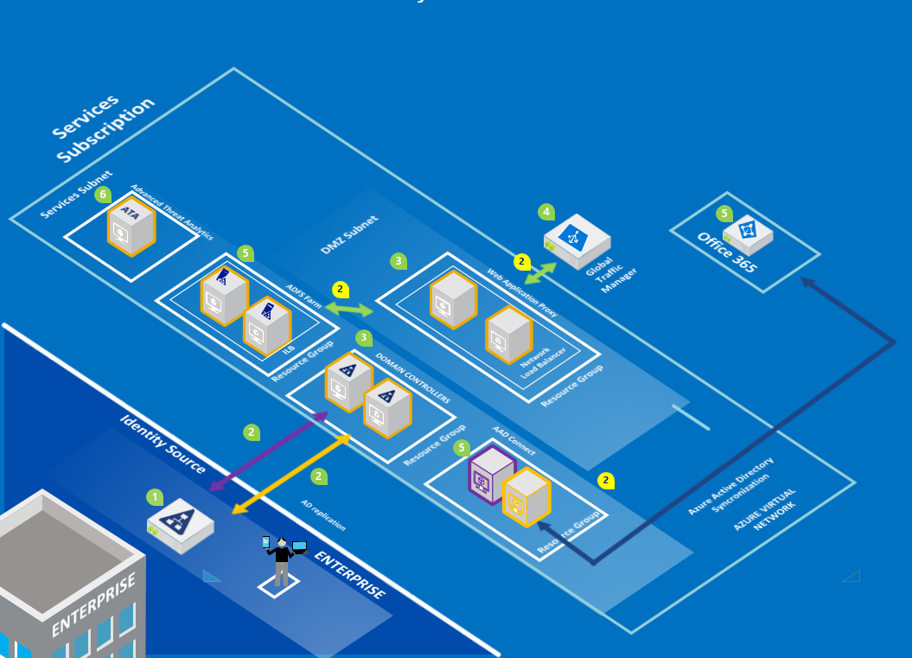
Resilient Identity
Use Case: To enable hybrid identity for Azure, geo-redundancy for on premise identity, enable other Azure workloads, such as Disaster Recovery.
Optional: Include AAD Connect for MAG
Notes:
https://microsoft.sharepoint.com/sites/Infopedia_G01KC/_layouts/15/WopiFrame.aspx?sourcedoc=%7b3af0b432-edbf-4f43-8c6f-cacf9443fd18%7d&action=default&DefaultItemOpen=1

Slide 37
Summary of Resilient Identity Workload
AzureFoundation Identity Pattern
Service type | Custom name | Region | Description | SKU | Estimated Cost
Virtual Machines | Virtual Machines for Identity Pattern | US Gov Iowa | 8 Standard virtual machine(s), A2 (2 cores, 3.5 GB RAM, 135 GB disk, $0.166/hr) size: 744 hours | N7H-02629 | $988.03
VPN Gateway | VPN Gateway | US Gov Iowa | standard tier, 744 gateway hour(s), 1000 GB outbound vpn | N7H-04005, Q5H-00025 | $287.56
Storage | DR Backups | US Gov Iowa | 1500 GB storage Page Blob and Disk type. Basic tier, LRS redundancy, 100 x100,000 transactions | N9H-00114, N9H-00803 | $92.31
OMS | Monitoring, Backup, and Site Recovery | US Gov Iowa | 8 instance(s) of Operations Management Suite | 7U9-00008, 7U9-00003 | $248.00
Support |  |  | Free level | Support | $0.00
 |  |  |  | Monthly Total | $1,615.90
 |  |  |  | Annual Total | $19,390.82
Disclaimer
All prices shown are in US Dollar ($). This is a summary estimate, not a quote. For up to date pricing information please visit https://azure.microsoft.com/pricing/calculator/channel/
MICROSOFT CONFIDENTIAL - SUBJECT TO NON-DISCLOSURE AGREEMENT NOTICE AND DISCLAIMER Prices and other terms of purchase are controlled by the agreement you enter with Microsoft, not this document. While we strive for accuracy the content is believed to be accurate as of the date of listed above, this information is subject to change at any time without Notice and should not be interpreted to be a commitment, guarantee, or offer by Microsoft. MICROSOFT MAKES NO WARRANTIES, EXPRESS, IMPLIED OR STATUTORY, AS TO THE INFORMATION IN THIS DOCUMENT
If you would like to share this information externally, please copy and paste only the necessary content into a customer ready presentations or models.
This estimate was created at 11/15/2016 5:37:15 PM UTC for willst@microsoft.com.

Slide 38
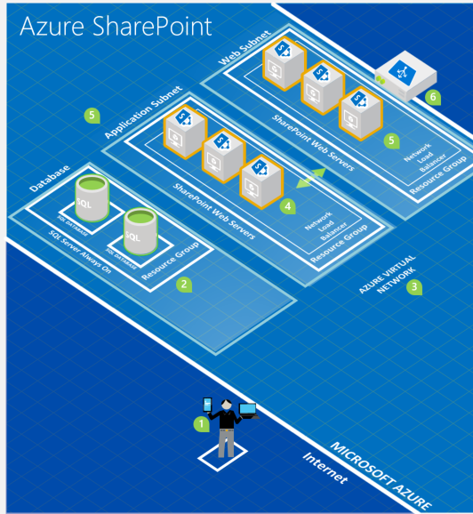
Highly Available SharePoint Farm
Use Case: Public Facing anonymous websites with hybrid integration to directories for some relationships
Secure design to isolate users from data.
Scalable approach to support the largest customers.

Slide 39
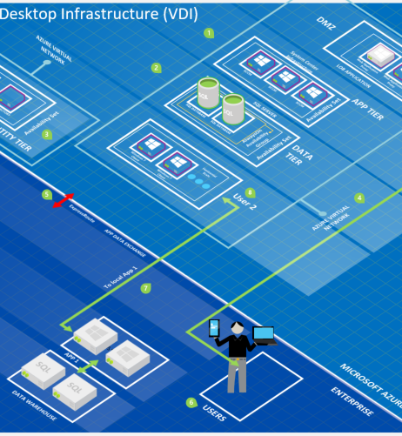
Highly Available Remote Desktop Services
Use Case: Internal enterprise user desktop or application specific server cluster for mission critical workloads.
Secure design to isolate users from data.
Scalable approach to support the largest customers.

Slide 40
Networking

Slide 41
Hybrid Networking
Endpoints
Remote Desktop Client (Jumpbox)
AAD Proxy or Web Application Proxy (WAP) for Modern Authentication
PowerShell
Internet Applications
VPN
On Premise network to Azure
Connections between Azure Datacenters
Connections to other Agencies
ExpressRoute
Private Peering
Public Peering
Microsoft Peering

Slide 42
Hybrid Networking Design
Hybrid Connectivity
Production VNET
HBI VNET
Preproduction VNET
Storage VNET
Services VNET
JSON Configuration (ARM)
Metadata Spreadsheet
Notes:
https://technet.microsoft.com/en-us/windows-server-docs/security/securing-privileged-access/privileged-access-workstations

Slide 43
AzureFoundation with One Region
In this design decision, the AzureFoundation is deploying a single Azure Region (data center) and a Site to Site VPN.
The VPN is configured with Active/Active so that the on premise enterprise router can have a redundant connections to the site.
The site is allocated a /18 address space, with five VNETs configured in a Hub and Spoke topology.
Workloads are usually deployed in the Spokes of the network with the exception of common services like resilient identity.

Slide 44
AzureFoundation with Two Regions
georedundant
01
Vnet2Vnet connection.
02
Active/Active VPN tunnel for availability.
03

Slide 45
AzureFoundation with Four Regions
Two sets of regional pairs
A Site2Site between Regional Pairs (optional)

Slide 46
AzureFoundation with Redundancy
Second on-premise location.
dynamic routing technology.
Notes:
https://docs.microsoft.com/en-us/azure/architecture/reference-architectures/hybrid-networking/hub-spoke

Slide 47
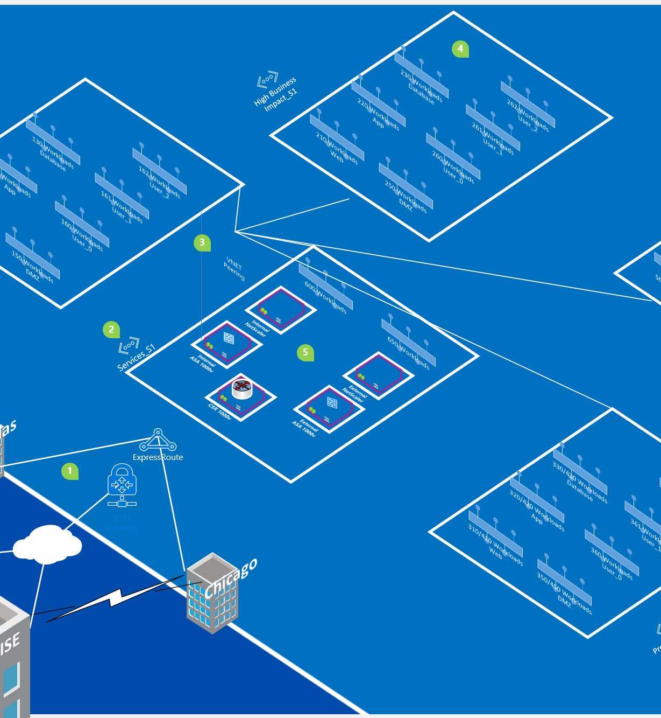
Hybrid Network Integration
Four Datacenters
Hybrid Connectivity
Subscription Subnets:
Hybrid Network
Centralized Network and Identity
VNET Peering and Gateways
Named Subnets, NSG and USR
Network Virtual Appliance ready.
JSON Configuration (ARM)
Metadata Spreadsheet
Notes:
https://technet.microsoft.com/en-us/windows-server-docs/security/securing-privileged-access/privileged-access-workstations

Slide 48
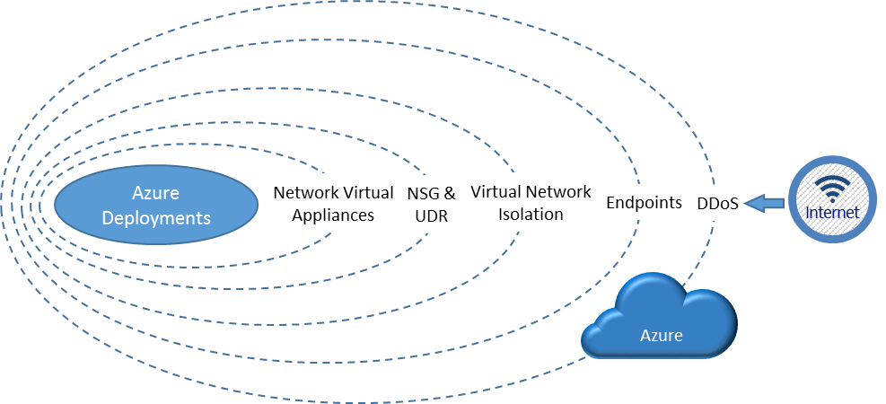
Azure Built In Security
Network Security Group:
External Subnet DMZ (deny all unless expressly permitted)
Internal Networks
Web
App
Database
User Tiers
User Defined Routing (Coming Soon)
https://azure.microsoft.com/en-us/documentation/articles/best-practices-network-security/
Notes:
Is there a way to do a Host Defined Route to bypass the UDR route. Is this possible?

Slide 49

AzureFoundation VNET Design
RFC 1918 IPv4 addresses THEY ARE FREE!
10.0.0.0/16 (Suggest starting at 10.128.0.0)
172.16.0.0/16 (172.16.0.0 – 172.16.31.255.255)
Goal: Avoid Conflict
What to ask for: Could you assign a Class B IP Address to host four Azure datacenters? Common response: “we are only putting a few things in Azure why do I need 65,000+ hosts?” Remember the goal and that RFC 1918 addresses are Free. The AzureFoundation will use the /16 to address up to four Azure locations with a highly available geo-redundant secure network layout that will enable most workloads.
Notes:
Start at 10.128.0.0 because it will most likely not have been used by previous implementations and help with the goal of avoiding conflict.

Slide 50

AzureFoundation Virtual Network Appliances Justification
Azure’s Software Defined Networking gives administrators the ability to control routing with User Defined Routing.
Virtual Network Security Appliances Use Cases:
Authentication and authorization prior to allowing access to your application
Intrusion detection and intrusion response
Application layer inspection for high-level protocols
URL filtering
Network level antivirus and antimalware
Anti-bot protection
Application access control
Additional DDoS protection (above the DDoS protection provided the Azure fabric itself)
Notes:
Start at 10.128.0.0 because it will most likely not have been used by previous implementations and help with the goal of avoiding conflict.

Slide 51
Databases and Storage

Slide 52
Data Pipeline Pattern

Slide 53
KeyVault Integrated Storage
Manage access to Storage Accounts using KeyVault
Notes:
https://docs.microsoft.com/en-us/azure/key-vault/key-vault-ovw-storage-keys

Slide 54
Developer Tools

Slide 55
Visual Studio Team Services
Use Case: A state of the art development environment that will enable continuous integration.

Slide 56
Contoso Branches

Slide 57
M365 Modern Workspace

Slide 58
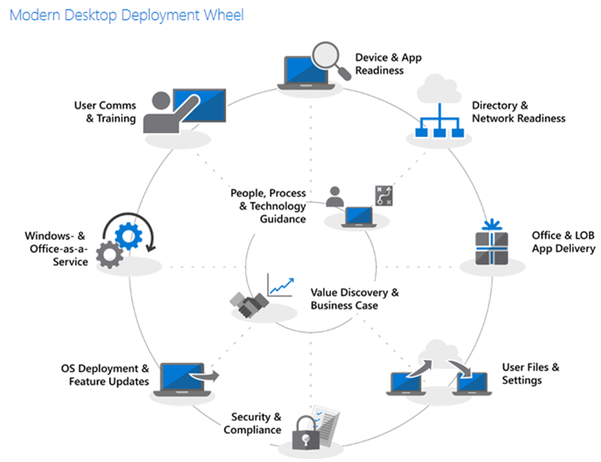
Windows Modern Desktop Shift
Information on how to “shift” to a Modern Desktop. This includes some nice, snappy videos on Microsoft Mechanics that are aligned to each aspect of the Modern Desktop
Try to configuring this in the Microsoft 365 Modern Desktop Lab that we provide along with step-by-step guides before touching their production environments.
When talking to customers I always share this lab as my favourite training tool, along with the following for gaining more in-depth knowledge: docs.microsoft.com Microsoft Ignite YouTube channel Microsoft Mechanics Youtube channel
Microsoft Virtual Academy

Slide 59
Configure AzureFoundation

Slide 60
Metadata Interview
Goto https://github.com/willstg/AzureFoundation and navigate to the Metadata folder, download and rename the spreadsheet by adding the account name to the spreadsheet. (Sorry it is so big)
Start from Left to Right, one of the first tabs outlines the interview process
How many departments does the account require? Similar to “how many forests/domains do I need”, less is more, however there are good reasons for separation. For example, a state agency may have their own budget and have very different business models then other state agencies where Department separation makes perfect sense. Another example, local Police Departments versus central IT where they want to make sure that no opportunity for cross contamination of resources.
Is it a centralized or decentralized model?
Do agencies/departments have their own procurement powers?
Do they outsource or is all work done in-house?
Are their agency/department resources shared or separated?
Do they need special security around the shared/separated resources?
Subscription Naming Conventions could be no changes, or customized. Option to have less subscriptions.
Decide what four datacenters to use, reference the Azure Data Center Pair documents to make sure there is an understanding on the Azure failover design.
Determine if Network Virtual Appliances (NVA) will be used in conjunction with the Azure Software Defined Networking. Update the Subnets that will be subjected to the User Defined Routing rules.
Introduce ExpressRoute and the path to integrate with IPSec VPNs (Dynamic or Static routing).
Local Networks, IP space that will be accessible from Azure’s private connections.

Slide 61

Partners who will deploy the AzureFoundation
https://aka.ms/AzureFoundation

Slide 62
Introduction to AzureFoundation Metadata
The AzureFoundation\Metadata folder, look for XLSX spreadsheet
Create a Fork of the spreadsheet in your own customer directory
Workbooks in the Spreadsheet (see Left)
Work Left to Right where Notes are included on features and functionalities of the spreadsheet.
Enterprise Enrollment Setup Notes
Departments to Configure
Subscriptions To Create
Locations where workloads will be deployed
VNET Pattern based on Class B
Subnet Pattern
Local Network Definition (Routing Table)
Network Security Groups
Network Security Rules
User Defined Routes
Storage Accounts
Users
Server Build Sheets
Azure Specs

Slide 63

What’s in a Pattern
The EA Portal and Account Portal have a Read Only API, which prevent us from writing automation to deploy “Departments”, “Account” and “Subscriptions”. Thus, the metadata gives a naming convention to follow and use in the “click, click, click” interface.
Naming conventions are formulas that help the enterprise classify data. The metadata uses formulas to match the enterprise naming conventions. This is a template, it can be modified.
When the network team offers to design the IP addresses, the AzureFoundation pattern is now an example and all the template work available will need to be reproduced.

Slide 64

Compute Build Sheets
Patterns are modelled in a spreadsheet giving a safe level of abstraction.
Common Workloads
Identity Pattern (7 Servers)
SharePoint Pattern (11 Servers)
SQL Server Pattern (3 Servers)
Remote Desktop Server Pattern (7 servers)
Naming Conventions are formulas
Known issues:
the spreadsheet is cumbersome, needs improvements.
ServiceNow, Remedy or other ITSM systems may be better suited for provisioning workloads.

Slide 65
Implement the spreadsheet

Slide 66

Get a partner!
Microsoft Premier “Azure Faststart”
Catapult “Cloud Foundation”
Planet “Cloud Foundation”
Do you have a partner already?
In the Presentations folder
Additional workloads are available to snap into Foundation.

Slide 67
Common Concerns: Storage Account
Operating Systems
Only put five virtual machines per storage account
Make a new storage account with a new name that is unique
Data Drives
Data drives get a drive letter other than D, D is a temp drive
Make a new storage account for data drives and only put five servers per storage account.
Database Drives
Databases are IO intensive requirements and a specific storage account should used for each database resource.
Images
For deploying images, the image has to be hosted in the same storage account as the VM.

Slide 68
Common Concerns: Virtual Networks
Site to Site VPN
Dynamic Routing is required to get the networks to communicate
Some of the on premise network appliances are not capable of doing Dynamic Routing.
VPN Peering for Roadmap
In the future the default S2S VPNs between subscriptions can be replaced with Vnet Peering.
Network Security Groups
The default NSG will only be to prevent inbound internet for the non-DMZ subnets, and port 443 Inbound from the internet.
ExpressRoute
Most enterprise configurations will find performance and operational improvements by using ExpressRoute.

Slide 69
How to Access Azure

Slide 70

Portals
Enterprise Enrollment Portal: https://ea.azure.com
Public Cloud:
MAC Account Portal: https://account.windowsazure.com
MAC Azure Management: https://manage.windowsazure.com
MAC Support: http://aka.ms/AzureEntSupport
Office Portal: https://portal.office.com
Managing Azure Subscriptions with PowerShell here has some additional discussion
Review of the Azure Portal here.
US Government Cloud
Microsoft Azure Government [MAG] Account Portal: https://account.windowsazure.us
MAG Azure Management: https://manage.windowsazure.us
MAG Support: http://aka.ms/azuregovsupport
Azure Government Documentation
Getting Started with Azure PowerShell for Azure Government blog here.
Notes:
Introduction to the Web Browser Portals…

Slide 71
API Access to Azure
Visual Studio and PowerShell ISE
Security Keys, Published Settings File
Portal Role Management
Azure Resource Management (ARM)

Slide 72

Enterprise Portal
Use the answers provided in the Department worksheet in the AzureFoundation Spreadsheet (AFS) to setup the Enterprise Enrollment.
Leverage the “Notes” worksheet in the AFS for step by step guidance.
Make “Service” users for Department and Account Administrator roles, it seems losing passwords or organizational change as users move to new roles causes unexpected delays.
Global Administrators in the Azure Active Directory is very powerful, consider they can reset anyone’s password and impersonate that person, including the Enterprise Administrators.

Slide 73

Account Portal
This is where subscriptions are made and renamed to align to the AzureFoundation pattern.
Every subscription name should be unique, use the naming convention agreed to in the spreadsheet.
Before changing the “Service Admin” for the subscription, consider that using the Account Administrator as the standard will allow for people to change roles.

Slide 74

Management and Resource Portal
The subscription is where workloads are deployed in Azure.
01
Set up the Co-Administrator for each Subscription.
02
Role Based Access Control
03

Slide 75
Azure Storage Explorer
https://blogs.msdn.microsoft.com/azuregov/2016/09/20/how-to-use-storage-explorer-with-microsoft-azure-for-government/

Slide 76

Future Goals
Replace the spreadsheet with an Application and wizard
Have PowerShell/ARM templates managed in Visual Studio Team Services
More Workloads, added to the AzureFoundation Library. These workloads can be found in the ARM/Compute folder

Slide 77
Operations

Slide 78
Azure Management Suite
The Azure Government Cloud IAAS environment is a: Robust , Secure, Stable computing environment. However, it is extension of your Mission Critical Data Center that needs to be Managed, Monitored, Backed-up and DR enabled for 24X7 operations
To meet and exceed these requirements Microsoft recommends the included Azure Management Suite of products. These products are not required to run your workloads in Azure, but will provide you a well managed environment

Slide 79
Microsoft Operations Management Suite (OMS) Simplified IT management for any enterprise
Gain control over any hybrid cloud. Manage Microsoft Azure or Amazon Web Services (AWS), Windows Server or Linux, VMware or OpenStack—all with Microsoft Operations Management Suite (OMS), our cost-effective, all-in-one cloud IT management solution.
Microsoft OMS: is the IT management solution for the hybrid cloud. Used alone or to extend your existing System Center deployment, OMS gives you the maximum flexibility and control for cloud-based management of your infrastructure. With OMS, you can manage any instance in any cloud, including on-premises, Azure, AWS, Windows Server, Linux, VMware, and OpenStack, at a lower cost than competitive solutions. Built for the cloud-first world, OMS offers a new approach to managing your enterprise that is the fastest, most cost-effective way to meet new business challenges and accommodate new workloads, applications and cloud environments.
Simplicity: A single portal for all your management tasks. No infrastructure to maintain.
Time to value: Onboard fast. No content to create. Connects to your on-premises datacenter.
Easy to integrate: Add new servers, or connect to your existing management tools within minutes.
Hybrid and open: Manage workloads across Windows and Linux, hybrid and public clouds, Azure and AWS.
Optimized for System Center: Complements your System Center investment to unleash new management scenarios.
Key Capabilities
Provides enterprise-class, realtime operational intelligence across hybrid environments.
Simplifies cloud management with process automation and monitoring of resources.
Better ensures preparedness in the event of a disaster with cloud-based availability.
Protects privacy and security of data, while delivering software and services to manage the IT infrastructure.

Slide 80
Azure Site Recovery
Full Featured Disaster Recovery
Protect-to-and-Recover-in-Azure: Replicate and failover your on-premises applications to Azure, negating the need to build and manage a second datacenter for recovery. Reduce expenses and only pay for compute when you need it.
N-Tier Application Consistency: Detect and stage mult-tier applications and restore them as a group, with specified startup ordering and the ability to insert scripts to bypass the need for manual configurations.
Application Replication Support: Benefit from using SQL AlwaysON and Active Directory replication when your databases and infrastructure components need the least possible RTO. Leverage ASR’s inbuilt replication technologies when the same replication technology for all tiers is adequate to meet your application’s recovery objectives.
No Impact Recovery Plan Testing: Perform periodic DR drills and testing without any impact to the production or recovery virtual machine.
Automated VM Protection and Replication
Enable policy-based replication and protection for thousands of virtual
machines using a few simple steps
At-Scale Configuration: Configure protection and disaster recovery networking settings that apply to your applications or your entire datacenter for seamless recovery.
Low Recovery Point Objective (RPO): Achieve near-synchronous RPOs, as low as 30s, even when using Azure as your recovery site.
Quick Recovery: Recover from disruptions within minutes and benefit from Azure’s 99.9% uptime guarantee.
Data Security and Secure Transmission: Data is encrypted when in transit and at rest in Azure.
One-Click Orchestrated Recovery
Automated Failover and Manual Actions: Leverage scripts and Azure Automation Runbooks to achieve optimal RTO and reduce human errors during recover
Automated Failback and Reverse Replication: Failing back to your primary datacenter is just as important as the initial failover. With ASR it is as easy as one click, and comes with the same data protection guarantee as failovers.
Remote Health Monitoring and Extensibility
With ASR, you also get proactive, continuous monitoring and alerting on issues before your business is impacted. Meet audit and compliance requirements using our robust reporting capabilities. Leverage our capacity planning resources to better plan your resource provisioning and usage. With ASR’s PowerShell support, you also get the ability to extend and integrate ASR’s functionality.

Slide 81
Azure Backup For Physical, Hybrid, and Cloud Environments
Azure Integrated Backup Solution
Azure Backup protects your data in the cloud and optionally can be integrated with System Center Data Protection Manager for advanced workload protection.
Data protection schedules can be daily, monthly, weekly, and yearly with retention up to 99 years in Azure
Protects workloads running in Azure, in VMs, or on physical servers
Centralized monitoring and reporting across on premises and Azure
Automated, Reliable and Secure
Scheduling: Customers can specify daily, weekly, monthly and yearly policies
Retention: Data can be retained in Azure for up to 99 years
Throttling: Network throttling can be configured so that optimal bandwidth usage happens during off-peak time
Incremental: After the initial seeding, backups are incremental, ensuring that resources such as storage and bandwidth are efficiently used
Compression: Data is compressed on the client side so there is less bandwidth consumption and less storage consumed
Secure: Data is encrypted in your datacenter and stored encrypted in Azure – the encryption key is stored and managed locally
Reliable: 3 copies of the data are stored to a single datacenter location and optionally at an additional, remote datacenter
Advanced Workload Protection
Protects files and folders from Windows Servers and Windows Clients
Integrates with SCDPM protects enterprise workloads including SharePoint, Exchange, SQL Server, and Hyper-V VMs
Protects guest workloads running in VMware environments
DPM works seamlessly with the Hyper-V Volume Shadow Copy Services (VSS) writer to ensure that consistent versions of virtual machines are captured and protected without affecting virtual machine access
Granular restore capability such as mailbox recovery for Exchange, DB level recovery for SQL, and ILR for SharePoint
Offline Seeding
Initial backups can be time-consuming and consume large amounts of bandwidth. With Azure Import/Export, the initial backup can be executed locally and then the physical media can be delivered to the nearest Azure datacenter

Slide 82
ASM to ARM Migration

Slide 83
Migrate from ASM to ARM
http://aka.ms/migaz
Roadmap working to get the AzureFoundation completely transitioned to ARM.

Slide 84
Azure Services Overview

Slide 85
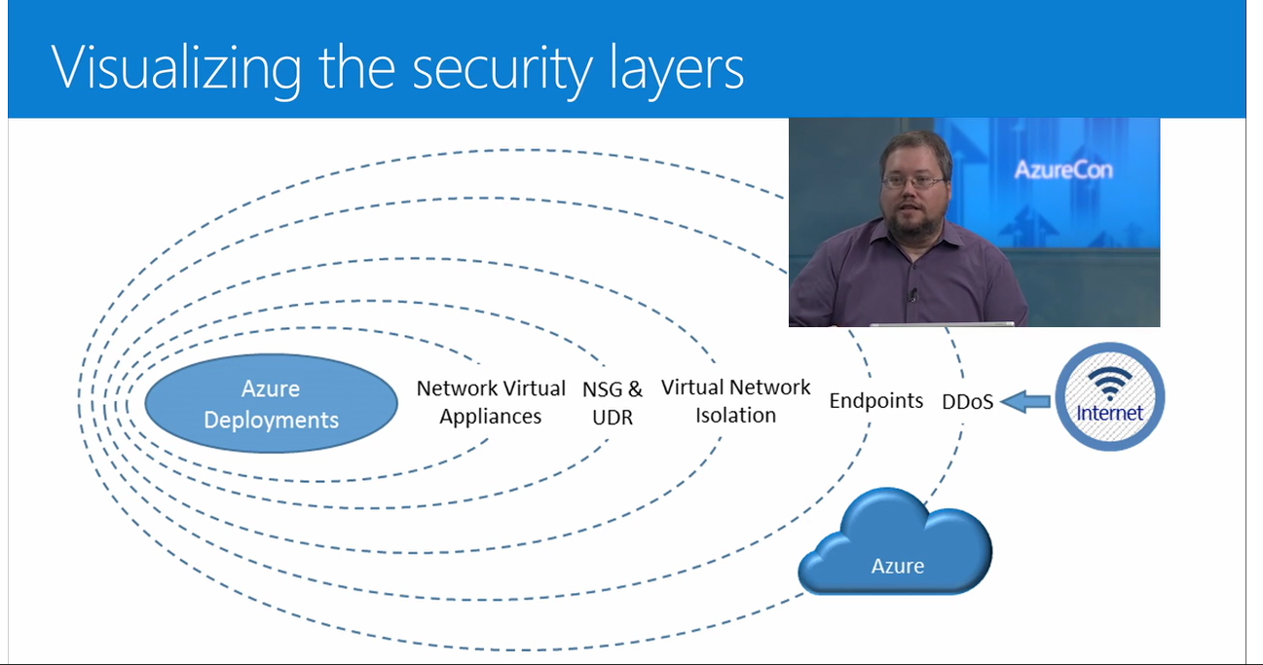
Notes:
https://azure.microsoft.com/en-us/documentation/videos/azurecon-2015-building-secure-virtual-networks-in-azure/

Slide 86
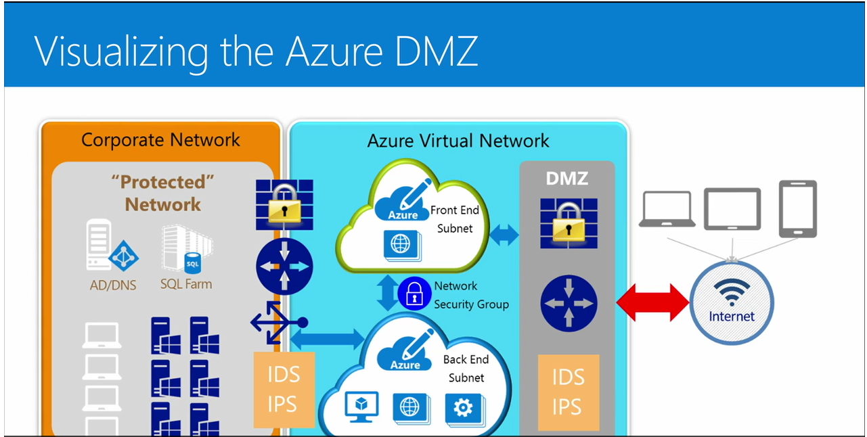

Slide 87
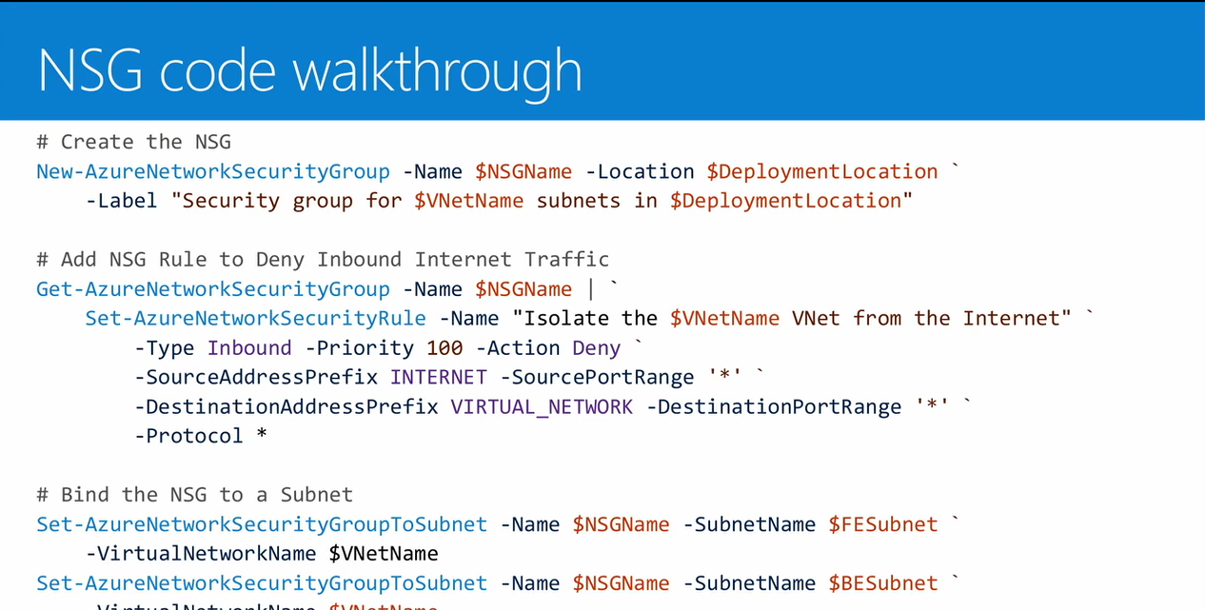

Slide 88
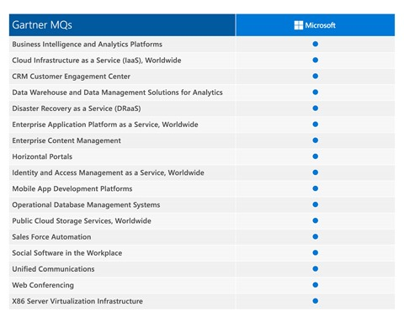
Gartner

Slide 89
Tools
Total Cost of Ownership Tool
Partner Investment Engine (PIE)
Yammer Group for Partners
Find available tenant names
AzureFoundation Pattern, look for utilities in the root of each ARM service directory at GitHub site.

Slide 91
Backup slides

Slide 92
Commercial and Sovereign Cloud Integration

Slide 93

Azure Commercial and Sovereign Clouds
There is physical separation by design in Microsoft Azure Commercial (MAC) and Azure Government (MAG)
Most enterprise customer would like to take advantages of both public and community cloud patterns.
Azure Commercial Cloud (MAC)
Good for Application Development Lifecycle management.
Template development
Latest and greatest capabilities of Azure
Azure Sovereign Cloud. (MAG)
Community specific, production workloads.
Good for secure regulated data stores and web applications
FedRAMP High, CIJS, IRS 1075

Slide 94
Commercial and Government
The Government Cloud is the same fabric (API) as the commercial cloud, however the competitive focus is on the Commercial cloud, and porting functionality to the Government cloud is prioritized based on demand.
Commercial Cloud Focus:
Development and Test Features. Ability to build a solution via a template and hydrate and destroy the solution on demand.
MSDN Features. The ability for the enterprise to combine the resources from their MSDN investment, saving on Azure compute for SQL, Windows and other Microsoft development efforts.
Visual Studio Team Services (VSTS) can be managed with Commercial subscription.
Template designs can be started with the large marketplace presence in the commercial cloud (>4500). These template solutions can be customized and jump start Government deployments.
Advanced workloads, such as IoT Hub, Cognitive Services, get features more quickly in the commercial cloud, allowing the enterprise to get a head start on incorporating these features into the government applications.
Identity flexibility, the ability to create AAD directory for B2C and B2B capabilities. Ability to leverage the O365 directory in PaaS solutions like Azure SQL.

Slide 95

Azure Active Directory with a Sovereign Cloud
The Azure Active Directory (AAD) that controls the administrative access to Sovereign (US Government Cloud) is isolated from the Office 365 Azure Active Directory.
Azure Active Directory Connect can still synchronize Sovereign Cloud AAD with Administrators
Sovereign Cloud Directory cannot have the same User Principle Names (UPN) as any other AAD.
AAD Connect can only synchronize to one and only one AAD.
Subscriptions in Sovereign Clouds can have one and only one AAD associated with any subscription in the enrollment.
Web Apps and App Services can be deployed with the sovereign cloud (administrators), while the application itself can be configured to any O365 or other AAD directory.

Slide 96
MAG Domain Masking Options
Option 1: 2nd AADConnect on premise Active Directory (also used for O365)
Motivation: By having a subset of users with access to the Government cloud, the enterprise will have a secure boundary that includes Identity’s privileged access to the Azure Sovereign cloud portal.
Justification: The need to create a new domain suffix is required because the same domain cannot be validated in two AAD directories. Single authoritative on premise Active Directory for all MAG administrative users synchronized.
Implications: (Currently testing in our lab) The domain suffix must be configured in the STS to point to the AAD that hosts the new domain suffix if the root suffix is already Federation. Pass thru works fine.
Option 2: Use B2B and change member types
Motivation: No need for users to maintain two accounts (and passwords). These users can be assigned privileged access to administer MAG resources.
Justification: Remove the Cloud Only creation of MAG administrator IDs.
Implications: Users must be changed from guest to members in most circumstances. The Users will lose access if they are removed from source directory, however the shadow account in the MAG AAD will be orphaned.

Slide 97
Identity Overview in the MAG
Complexity:
The MAG Azure Active Directory tenant is a unique directory, different than the Office365 Directory.
Design Patterns:
Cloud Only Identities (admin@magtaggov.onmicrosoft.com)
Domain Integrated identities, using AAD Connect, with a unique domain suffix: (example : admin@mag.msftgov.us), limitation of no pass-through authentication.
B2B Integrated identities (not available yet): (admin@msftgov.us)
Costs:
Administration, auditing, automation and policy associated with making Identities for the cloud may be a net new requirement for an organization.
An AAD Connect Server, in addition to the O365 AAD Connect Server, AD Administration to isolate an OU, Administrative steps to make individuals an Azure AAD Identity integrated with the current ID Creation process.
An invitation process, a cleanup process. Administration and auditing for who has access to what resources.

Slide 98
Why /16 versus /25
The overlay of a Router and a Firewall subnets will consume all but 10 IP addresses for any workload. Add a couple of domain controllers, 8 IP addresses, add in another infrastructure and the customer will have to request another set of IP addresses for any substantial workloads.
A /25 block approach, if played through a couple of years could result in a very disorganized network, difficult to manage and consistently requiring administration as IP workloads are added.
If the /25 approach uses public IP addresses, a large agency could consume a /16 of address space, which could be impossible to procure.
By assigning each agency a /16 address block, summarization of cloud workloads are straight forward. Every subnet in the datacenter would be known by the agency and operations.
Automations can focus on a foundation that is well defined up front.
Security can focus on a network foundation that is consistently deployed with ever agency, categorizing workloads based on business impact of the data and system functionality.
Financial accounting of workloads based on the business function will be clearly depicted in the financial statements.
A consistent deployment on all of the agencies will eliminate all defects by having a process driven quality approach

